Slide 1
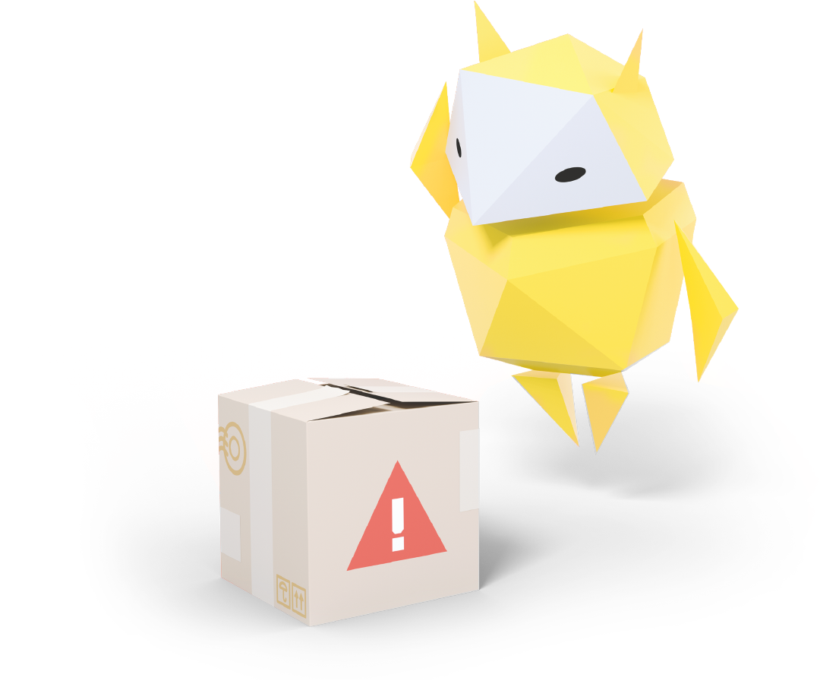
Spotting Fake Information Online
How to decide if something is unreliable or untrue

Slide 2
How confident do you feel about knowing what is true or fake online?
Not at all confident
Quite confident
Very confident
Notes:
Baseline Activity (10 mins)
Ask pupils to hold up traffic light cards to show how confident they feel about understanding what is true or fake online (red – not at all confident, amber – quite confident, green – very confident).

Slide 3
How can you tell if something on the internet is fake or unreliable?
?
?
Notes:
Baseline Activity (10 mins)
Write the following question on the board: ‘How can you tell if something you see or read on the internet is fake or unreliable?’
Think, pair, and share.
Ask pupils to take one minute to think for themselves and then a few minutes to discuss in pairs. Then spend five minutes discussing as a class and write down what the pupils come up with. Examples may include:
• Pop-ups you didn’t click on appear asking for passwords and personal information.
• Weird photos on social media.
• Emails from strange addresses telling you that you’ve won a prize.

Slide 4
Don’t bite that phishing hook!
Knowing what’s real and what’s fake
Notes:
Be Internet Alert: Activity 1 - Don’t bite that phishing hook! (15 mins)
Divide the class into groups and give each group the sheet of example messages and websites from Be Internet Alert: Activity 1
Pupils decide which are real and reliable and which are fake and untrustworthy, giving reasons why.
Support and Extension
For pupils who need more support, use the real/fake clue cards (you will need to print duplicate copies of these) and ask them to match each card against the scenario they think it belongs to. Discuss the clues to ensure that they understand why the messages could be examples of scams or phishing. For pupils who need more of a challenge, ask them to write their own ‘Look out for Phishing!’ top five clues checklist.

Slide 5
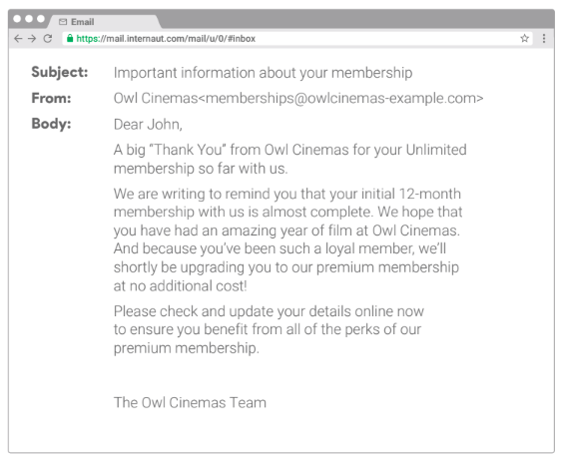
Real or fake?
Notes:
Be Internet Alert: Activity 1 - Don’t bite that phishing hook! (15 mins)
Divide the class into groups and give each group the sheet of example messages and websites from Be Internet Alert: Activity 1
Pupils decide which are real and reliable and which are fake and untrustworthy, giving reasons why.

Slide 6
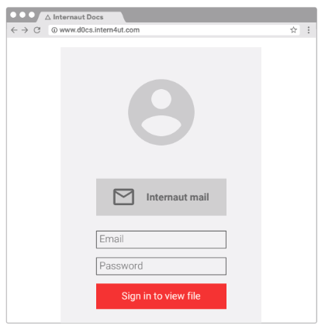
Real or fake?
Notes:
Be Internet Alert: Activity 1 - Don’t bite that phishing hook! (15 mins)
Divide the class into groups and give each group the sheet of example messages and websites from Be Internet Alert: Activity 1
Pupils decide which are real and reliable and which are fake and untrustworthy, giving reasons why.

Slide 7
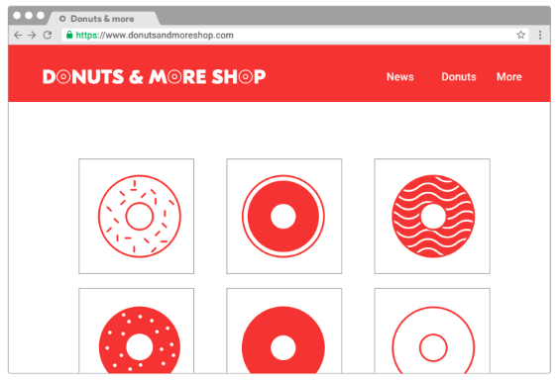
Real or fake?
Notes:
Be Internet Alert: Activity 1 - Don’t bite that phishing hook! (15 mins)
Divide the class into groups and give each group the sheet of example messages and websites from Be Internet Alert: Activity 1
Pupils decide which are real and reliable and which are fake and untrustworthy, giving reasons why.

Slide 8
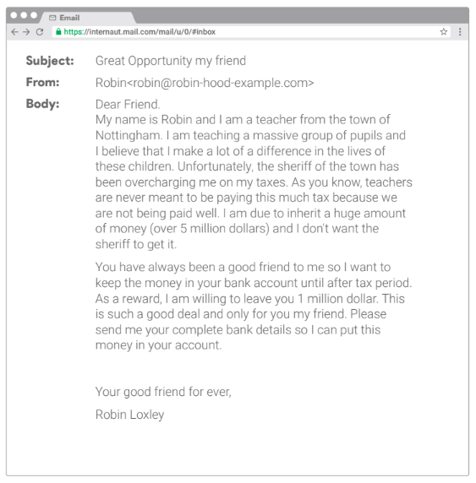
Real or fake?
Notes:
Be Internet Alert: Activity 1 - Don’t bite that phishing hook! (15 mins)
Divide the class into groups and give each group the sheet of example messages and websites from Be Internet Alert: Activity 1
Pupils decide which are real and reliable and which are fake and untrustworthy, giving reasons why.

Slide 9
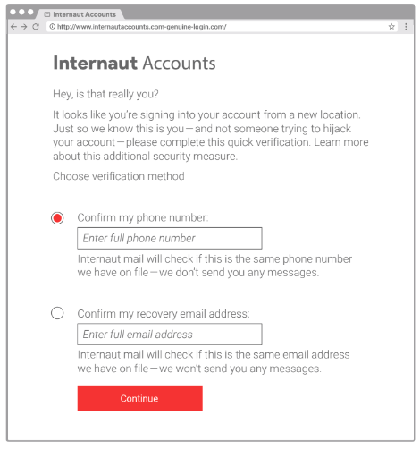
Real or fake?
Notes:
Be Internet Alert: Activity 1 - Don’t bite that phishing hook! (15 mins)
Divide the class into groups and give each group the sheet of example messages and websites from Be Internet Alert: Activity 1
Pupils decide which are real and reliable and which are fake and untrustworthy, giving reasons why.

Slide 10
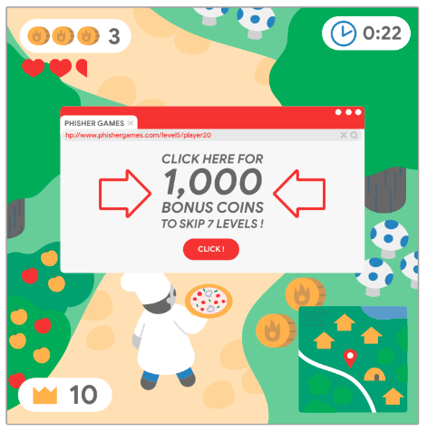
Real or fake?
Notes:
Be Internet Alert: Activity 1 - Don’t bite that phishing hook! (15 mins)
Divide the class into groups and give each group the sheet of example messages and websites from Be Internet Alert: Activity 1
Pupils decide which are real and reliable and which are fake and untrustworthy, giving reasons why.

Slide 11
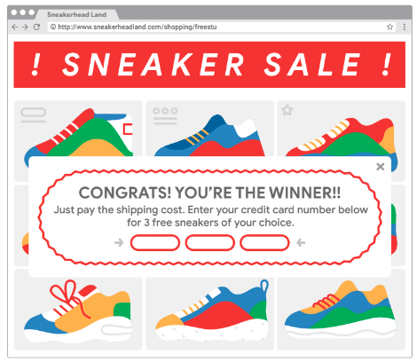
Real or fake?
Notes:
Be Internet Alert: Activity 1 - Don’t bite that phishing hook! (15 mins)
Divide the class into groups and give each group the sheet of example messages and websites from Be Internet Alert: Activity 1
Pupils decide which are real and reliable and which are fake and untrustworthy, giving reasons why.

Slide 12
Let’s practise…
Choose a scenario and read it to your group
How would you respond to this message?
What is the best option? Why?
Notes:
Be Internet Alert: Activity 2 - Who are you, really? (20 mins)
1. Each group picks a scenario from a container. One person in each group reads it aloud.
2. The group discusses possible responses to the message (and decides on three to six different options).
3. The group decides on which would be the best option and discusses why they think this.
Support and Extension
You could give pupils requiring additional support the differentiated list of scenarios and ask them to give reasons why they think the statements are unreliable (fake). For pupils who need more challenge, invite them to create their own advice tips for younger pupils.

Slide 13
Let’s talk!
Check the cheat sheet. Do you agree with it?
Share your group’s response – why did you choose that one?
Notes:
Be Internet Alert: Activity 2 - Who are you, really? (20 mins)
4. Each group is given the corresponding ‘cheat sheet’ to match their scenario. They discuss whether they agree with it, and compare it to their group responses.
5. Class feedback – display each scenario on the whiteboard. Each group explains what they decided was the best response and why – the class decides if they agree.
Support and Extension
You could give pupils requiring additional support the differentiated list of scenarios and ask them to give reasons why they think the statements are unreliable (fake). For pupils who need more challenge, invite them to create their own advice tips for younger pupils.

Slide 14
Time to visit…
Interland’s
Reality River
g.co/interland
Notes:
Be Internet Alert: Activity 7 - Interland: Reality River (20 mins)
Pupils now have the chance to play Reality River in Interland, you can do this as a class or on separate devices.

Slide 15
Let’s talk!
How did you decide what was real or fake?
What were the signs?
Notes:
Be Internet Alert: Activity 7 - Interland: Reality River (20 mins)
Questions to ask after playing Reality River:
• How did you know if something in the game was real or fake? What were the signs?

Slide 16
Let’s talk!
What is a Phisher?
What does it do and how does it affect the game?
Notes:
Be Internet Alert: Activity 7 - Interland: Reality River (20 mins)
Questions to ask after playing Reality River:
• What is a Phisher? What does it do and how does it affect the game?

Slide 17
Let’s talk!
Which clues in the game hinted that something was strange about certain situations?
Notes:
Be Internet Alert: Activity 7 - Interland: Reality River (20 mins)
Questions to ask after playing Reality River:
• Which clues in the game hinted that something was strange about certain situations?

Slide 18
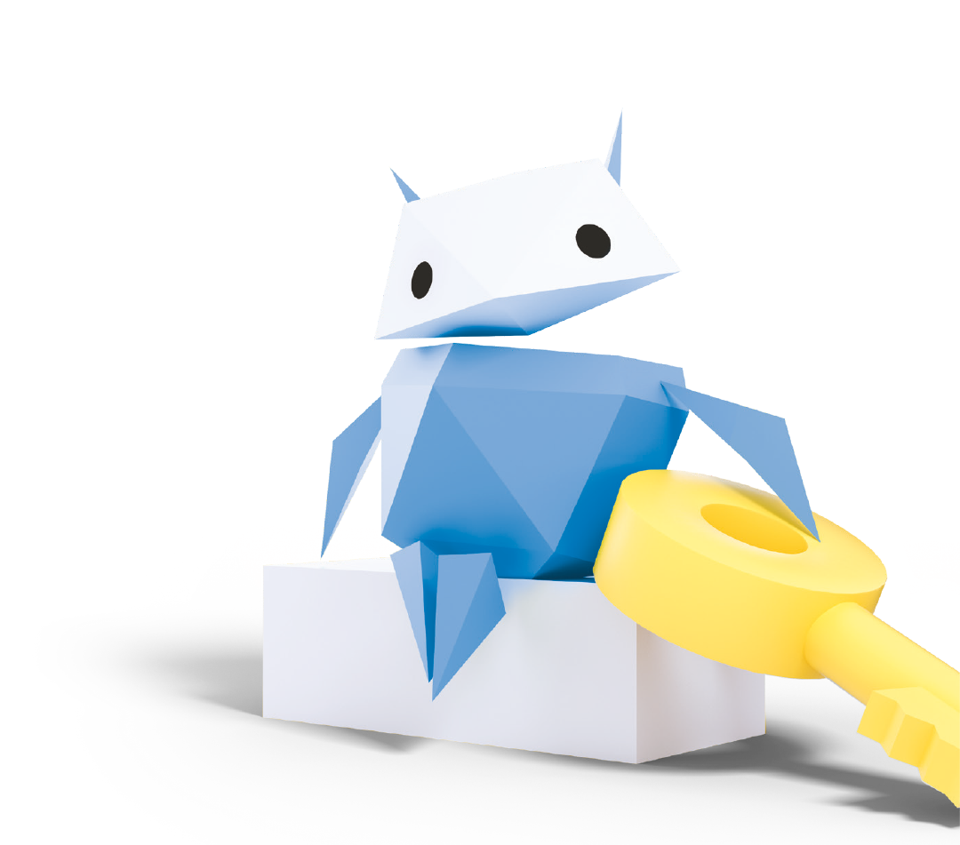
Let’s talk!
Do you think that playing this game will help you be safer online in the future?
Notes:
Be Internet Alert: Activity 7 - Interland: Reality River (20 mins)
Questions to ask after playing Reality River:
• Do you think that playing this game will help you be safer online in the future?

Slide 19
Let’s talk!
Now that you’ve played this game, what’s one thing you might do differently when you’re online in the future?
Notes:
Be Internet Alert: Activity 7 - Interland: Reality River (20 mins)
Questions to ask after playing Reality River:
• Now that you’ve played this game, what’s one thing you might do differently when you’re online in future?

Slide 20
Let’s talk!
What should you do if you’re unsure or worried about something you come across online? How?
Notes:
Be Internet Alert: Activity 7 - Interland: Reality River (20 mins)
Questions to ask after playing Reality River:
• What should you do if you’re unsure or worried about something you come across online?

Slide 21
Write down one thing you’d teach somebody about how to be Internet Alert
Examples
“Watch out for emails from an unknown sender telling him he has won an iPad. It’s probably too good to be true.”
“If you come across
a phishing email you should always report it.”
Notes:
Plenary (5 mins)
Ask pupils to write down one thing they could teach someone else about how to be Internet Alert.
Examples might include:
• I’m going to tell my teenage brother to watch out for emails from an unknown sender telling him he has won an iPad, as it’s probably too good to be true.
• If you come across a phishing email you should always report it.

Slide 22
Now how confident do you feel about knowing what is true or fake online?
Not at all confident
Quite confident
Very confident
Notes:
Plenary (5 mins)
Ask pupils to hold up traffic light cards to show how confident they now feel about how to be Internet Alert and critical of what they come across online (red – not at all confident, amber – quite confident, green – very confident).
Compare results with the start of the lesson to measure progress.
Extension
Ask pupils to compose a message or tweet for the school website informing their parents of the meaning of ‘Internet Alert’. Ideas of what to include could be:
• What the keywords mean.
• Clues to look out for that something online may not be all it appears.
• How and where to get support if someone is worried about anything they see online.

