Slide 1
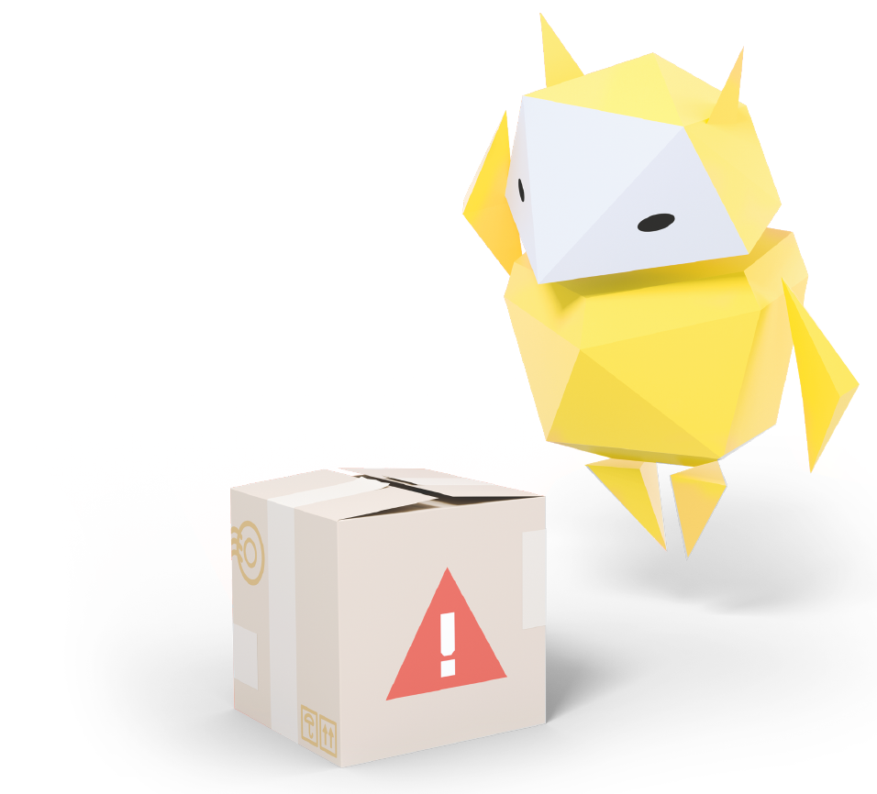
Handling & Reporting Mean Behaviour
What to do if you see something upsetting

Slide 2
Let’s talk!
What does it mean to be brave?
What do you do when you see something unkind online?
What do we do when we see something we don’t like online?
Notes:
Baseline Activity
(5 mins)
Recap prior learning – what does it mean to be brave? What do we do when we see something unkind online? How about when we see something we don’t like?
Children practise being brave and calling out the behaviours or what they have seen with role play.

Slide 3
Let’s talk!
What happens to our bodies when we feel angry or upset?
Notes:
Be Internet Brave: Activity 4.2 - Handling mean stuff online (15 mins)
Pupils learn that behaviour, kind or mean, is just behaviour – whether online or offline.
They explore ways to handle the mean kind so they can avoid contributing to the drama and escalating conflict.
People can get into conflicts online for a lot of different reasons. We can avoid a lot of nastiness just by trying to show kindness to others – or just not getting involved. Sometimes it continues from something that happened at school. Other times, though, people just say or do mean things out of the blue.
Discuss what happens to our bodies when we feel angry or upset and what strategies we use to overcome them.

Slide 4
Let’s practise…
Write down one situation you might encounter where someone is being nasty online.
Get into groups and complete section A on your worksheet.
Notes:
Be Internet Brave: Activity 4.2 - Handling mean stuff online (15 mins)
In groups, pupils work together to complete the worksheet from Be Internet Brave: Activity 4.2 to come up with a situation they may come across where someone is being mean online (e.g. in-game chat).

Slide 5
Let’s practise…
Swap your sheet with the group next to you and complete section B on their sheet.
Using their scenario, decide how you would respond and explain why?
Notes:
Be Internet Brave: Activity 4.2 - Handling mean stuff online (15 mins)
This sheet is then swapped with another group and they have to respond to a new situation, considering how and why they would respond in a certain way.

Slide 6
Let’s talk!
How did you decide to respond?
Why did you choose that response?
Notes:
Be Internet Brave: Activity 4.2 - Handling mean stuff online (15 mins)
Have each group share their answers with the class and discuss them together.

Slide 7
Asking for help is brave
We’re going to look at some scenarios.
After you have read them, think about if they’ve ever happened to you.
If you feel able to, share with us what you did, or didn’t do, and why.
Notes:
Be Internet Brave: Activity 5 - When to get help (15 mins)
One piece of advice that appears consistently throughout these lessons is: if pupils come across something that makes them feel uncomfortable or worse, encourage them to report it – be brave and talk to an adult they trust who can help, including you, the headteacher, or a parent.
Children may feel that ‘telling’ on someone else is not a good thing and has been discouraged in the past. This is not the case when online and we need to be actively encouraging pupils to ‘talk it out’ when they come across things online that they do not like or makes them feel uncomfortable.

Slide 8
1
You need help remembering a password.
Notes:
Be Internet Brave: Activity 5 - When to get help (15 mins)
Work through the scenarios in the handout and discuss with children what they would do.

Slide 9
2
Another gamer really likes your skin and offers to pay you game money for it.
How do you decide?
Notes:
Be Internet Brave: Activity 5 - When to get help (15 mins)
Work through the scenarios in the handout and discuss with children what they would do.

Slide 10
3
You see some really mean behaviour in a video and aren’t sure what to do about it.
Notes:
Be Internet Brave: Activity 5 - When to get help (15 mins)
Work through the scenarios in the handout and discuss with children what they would do.

Slide 11
4
Another gamer asks how old you are and where you live.
Do you tell them?
Notes:
Be Internet Brave: Activity 5 - When to get help (15 mins)
Work through the scenarios in the handout and discuss with children what they would do.

Slide 12
5
A friend shows you a video that’s really violent – someone gets hurt in it.
What do you do?
Notes:
Be Internet Brave: Activity 5 - When to get help (15 mins)
Work through the scenarios in the handout and discuss with children what they would do.

Slide 13
6
You want to do something about a comment you see online that’s really mean.
What do you do?
Notes:
Be Internet Brave: Activity 5 - When to get help (15 mins)
Work through the scenarios in the handout and discuss with children what they would do.

Slide 14
7
Someone on the playground starts making fun of another child because they don’t have a phone, and they are really sad.
What do you do about that?
Notes:
Be Internet Brave: Activity 5 - When to get help (15 mins)
Work through the scenarios in the handout and discuss with children what they would do.

Slide 15
8
You’re watching a video of cartoon characters and all of a sudden something really scary pops up in the middle of it.
What do you do?
Notes:
Be Internet Brave: Activity 5 - When to get help (15 mins)
Work through the scenarios in the handout and discuss with children what they would do.

Slide 16
Do you know how
to report things online?
Do you know what community guidelines,
or terms of service, are?
Notes:
Be Internet Brave: Activity 6 - Report it online too (20 mins)
This activity teaches children what else they can do if they come across something upsetting or unkind online by reporting online.
You will be showing where community guidelines can be found and how to report things on websites that children are familiar with.

Slide 17
Do you know how to report something inappropriate when using an app?
Notes:
Be Internet Brave: Activity 6 - Report it online too (20 mins)
Using a school device to demonstrate where to go to report inappropriate content and behaviour in apps, the class considers various types of content, decides whether to report it and talks about why or why not.
This lesson teaches children what to look out for when online if they want to report something online – it shows children where the community rules are for a number of familiar websites.
It is also worth informing the children of websites such as CEOP or NSPCC.

Slide 18
Let’s practise…
We’re going to look at some more scenarios.
Would you report it online or in the app? Why?
Notes:
Be Internet Brave: Activity 6 - Report it online too (20 mins)
Using a school device to demonstrate where to go to report inappropriate content and behaviour in apps, the class considers various types of content, decides whether to report it and talks about why or why not.
This lesson teaches children what to look out for when online if they want to report something online – it shows children where the community rules are for a number of familiar websites.
It is also worth informing the children of websites such as CEOP or NSPCC.

Slide 19
1
Someone posts a group photo in a public account and you hate the way you look in it.
Would you report that photo or not?
If you know who posted it, would you talk with the person and ask them to take it down?
How can you respond?
Notes:
Be Internet Brave: Activity 6 - Report it online too (20 mins)
Ask children to read each scenario and raise your hand if you’d report it in the app or service where you found it.
Explain why you would or wouldn’t report it.
(Remember that there is seldom one right choice to make, which is why discussion is helpful. No one should feel bad about what they chose to do. Even adults don’t always know when or how to report.)

Slide 20
2
Someone creates an account of a pupil you know using their name and photo.
They turned the photo into a meme and drew a moustache and other weird facial features on it, turning the photo into a joke.
Would you report the account?
Notes:
Be Internet Brave: Activity 6 - Report it online too (20 mins)
Ask children to read each scenario and raise your hand if you’d report it in the app or service where you found it.
Explain why you would or wouldn’t report it.
(Remember that there is seldom one right choice to make, which is why discussion is helpful. No one should feel bad about what they chose to do. Even adults don’t always know when or how to report.)

Slide 21
3
Someone posts lots of mean comments about a pupil in your school without using their name, but you have a feeling you know who it is.
Would you report those comments or not and, if you would, how?
Notes:
Be Internet Brave: Activity 6 - Report it online too (20 mins)
Ask children to read each scenario and raise your hand if you’d report it in the app or service where you found it.
Explain why you would or wouldn’t report it.
(Remember that there is seldom one right choice to make, which is why discussion is helpful. No one should feel bad about what they chose to do. Even adults don’t always know when or how to report.)

Slide 22
4
Someone creates an account with your school’s name in the screen name and posts other pupils’ photos with comments that everybody hears about.
Some of the comments are hurtful to pupils, some are compliments.
Do you report the hurtful comments, the whole account or both?
Notes:
Be Internet Brave: Activity 6 - Report it online too (20 mins)
Ask children to read each scenario and raise your hand if you’d report it in the app or service where you found it.
Explain why you would or wouldn’t report it.
(Remember that there is seldom one right choice to make, which is why discussion is helpful. No one should feel bad about what they chose to do. Even adults don’t always know when or how to report.)

Slide 23
5
One night, you notice that a pupil has made a comment online saying they’re going to fight with another pupil in the dinner hall the next day.
Do you report that comment online or not?
Do you report it to a teacher or headteacher the next morning or not? Both?
Notes:
Be Internet Brave: Activity 6 - Report it online too (20 mins)
Ask children to read each scenario and raise your hand if you’d report it in the app or service where you found it.
Explain why you would or wouldn’t report it.
(Remember that there is seldom one right choice to make, which is why discussion is helpful. No one should feel bad about what they chose to do. Even adults don’t always know when or how to report.)

Slide 24
6
You’re watching a cartoon video and all of a sudden there’s some weird content in it that’s definitely not appropriate for children and makes you feel uncomfortable.
Do you report it or not?
Notes:
Be Internet Brave: Activity 6 - Report it online too (20 mins)
Ask children to read each scenario and raise your hand if you’d report it in the app or service where you found it.
Explain why you would or wouldn’t report it.
(Remember that there is seldom one right choice to make, which is why discussion is helpful. No one should feel bad about what they chose to do. Even adults don’t always know when or how to report.)

Slide 25
7
You’re playing an online game with friends and someone none of the players know starts chatting with you. They’re not being nasty or anything, but you don’t know them.
Do you ignore them or report them?
Notes:
Be Internet Brave: Activity 6 - Report it online too (20 mins)
Ask children to read each scenario and raise your hand if you’d report it in the app or service where you found it.
Explain why you would or wouldn’t report it.
(Remember that there is seldom one right choice to make, which is why discussion is helpful. No one should feel bad about what they chose to do. Even adults don’t always know when or how to report.)

Slide 26
Let’s talk!
What can you do or say when you see upsetting stuff online?
Notes:
Plenary
(10 mins)
Using flipchart paper, jot down ideas from the class on the key things they can do or say when they see upsetting stuff online.
Extension
Children find the community guidelines for their favourite websites and learn how to report things on these websites.
They could make a poster of how to report things on these popular websites to be displayed in the classroom/around the school.

