Slide 1
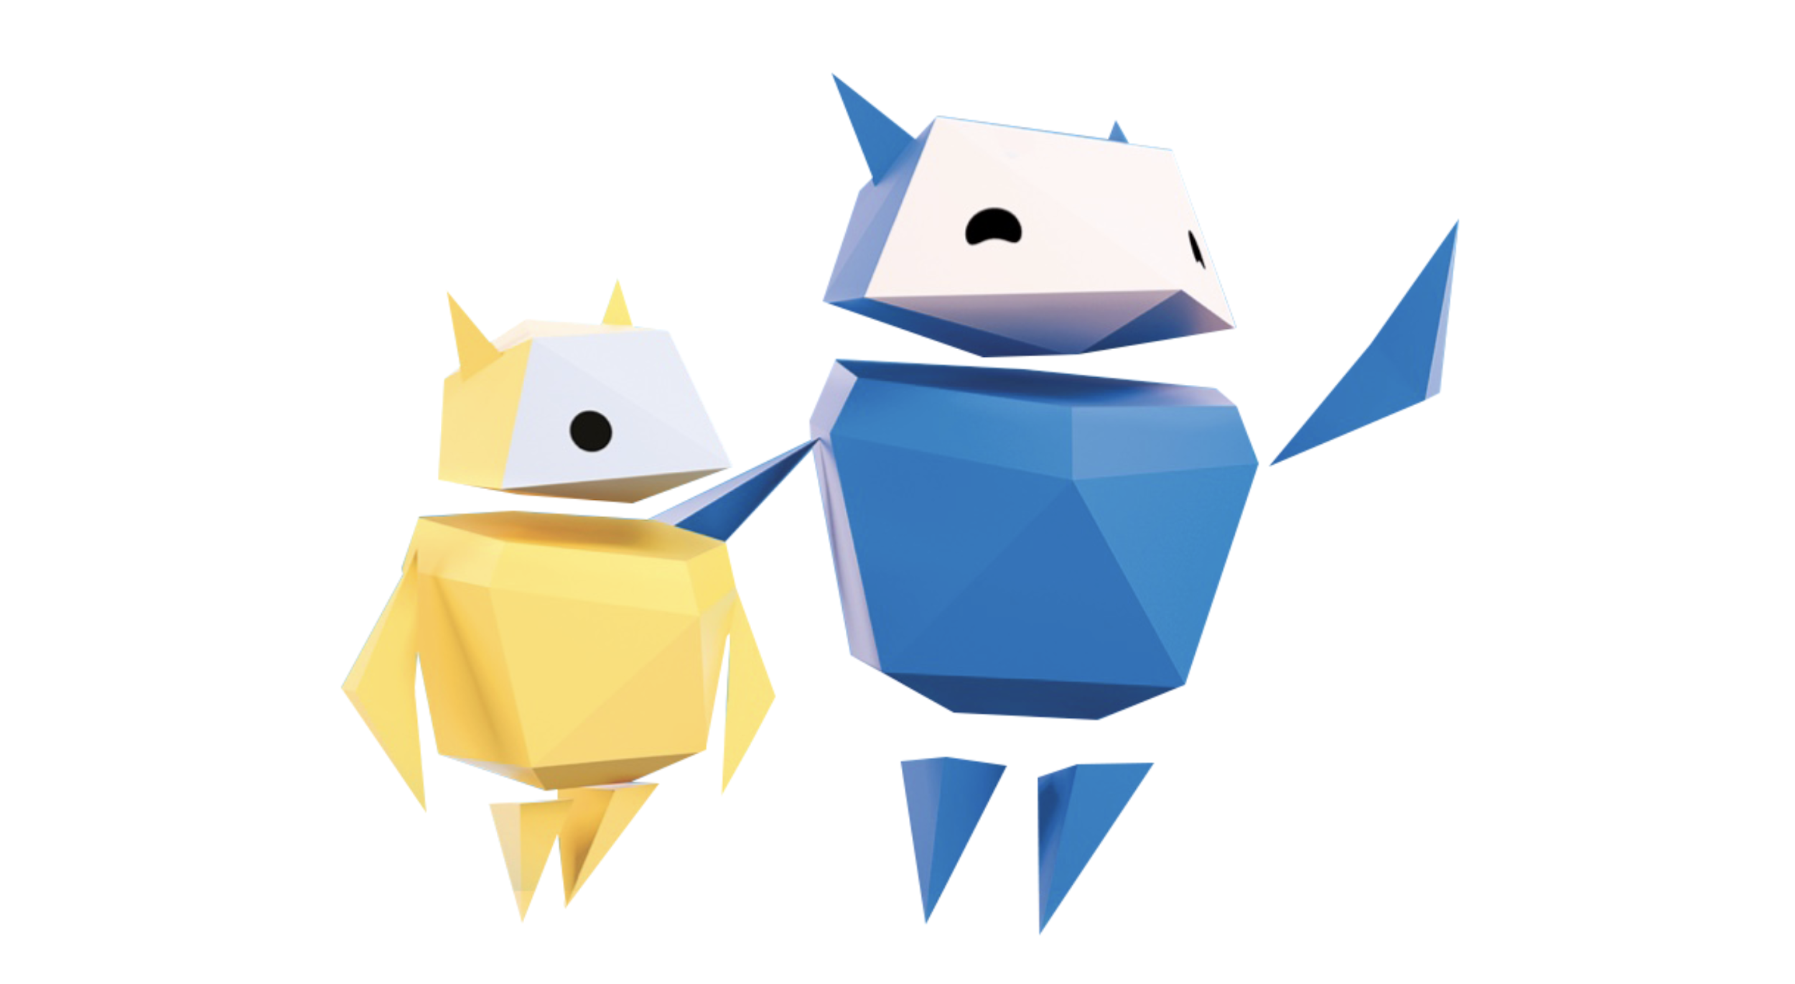
Passwords & Behaviour
Protecting yourself and others

Slide 2
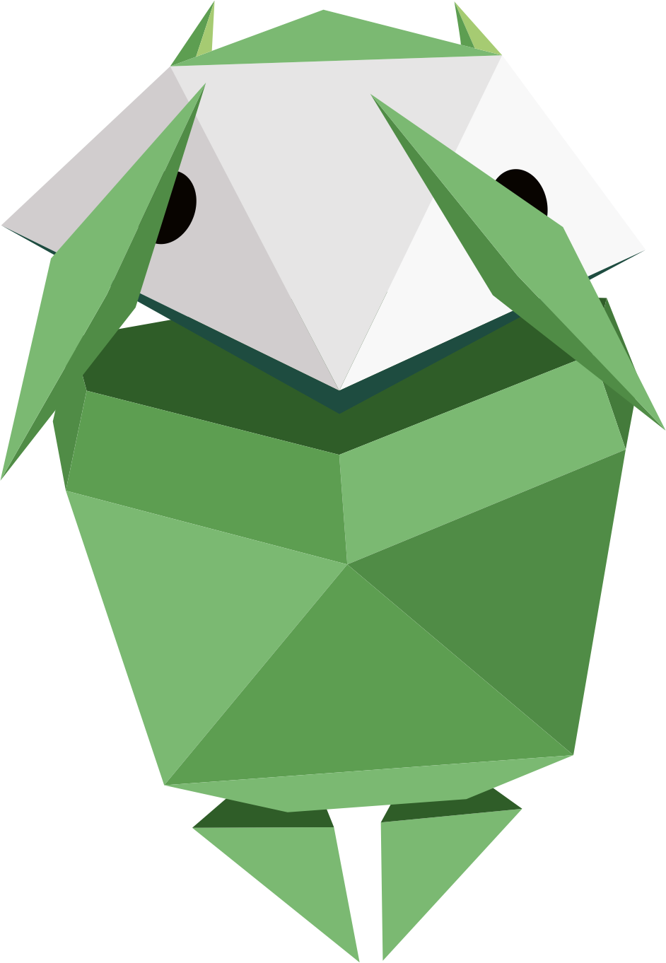
How confident are you in protecting your personal information online?
Draw a scale like this…
1 2 3 4 5 6 7 8 9 10
Not confident
Very confident
Notes:
Baseline activity
Protecting my personal information online: how confident am I?
Ask pupils to draw a scale from 1-10. 1 representing not at all confident, 10 representing very confident.
Invite them to mark on their scale how confident they feel in terms of their knowledge and understanding of protecting their own personal information online.

Slide 3
Now close your eyes…
Notes:
Baseline activity
Ask pupils to close their eyes and to put up their hand when you call out where they have rated themselves, 1-3, 4-7, 8-10. This will be revisited at the end of the lesson.

Slide 4
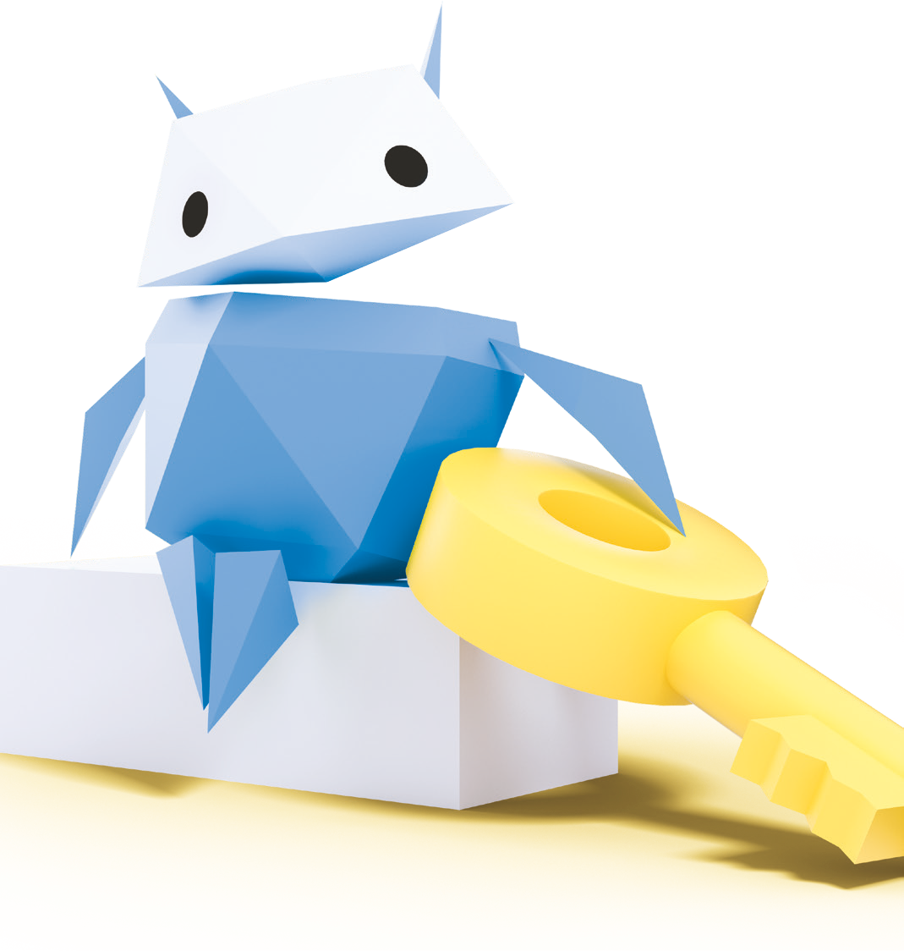
Why is it important to protect your personal information online?
Write down as many reasons as you can
Notes:
Baseline activity
Ask pupils to discuss in groups why it is important to protect personal information and to write as many reasons as they can on separate sticky notes.
Invite one or two pupils from each group to bring up their sticky note ideas and place on a flipchart/display board.
Summarise and share what pupils have written on their sticky notes.
Possible answers: people may access your home address, phone number, see photos, messages and emails that you don’t want made public, etc.

Slide 5
What is a password?
Why is it important?
Notes:
Baseline activity
Ask the pupils: what is a password and why is it important?

Slide 6
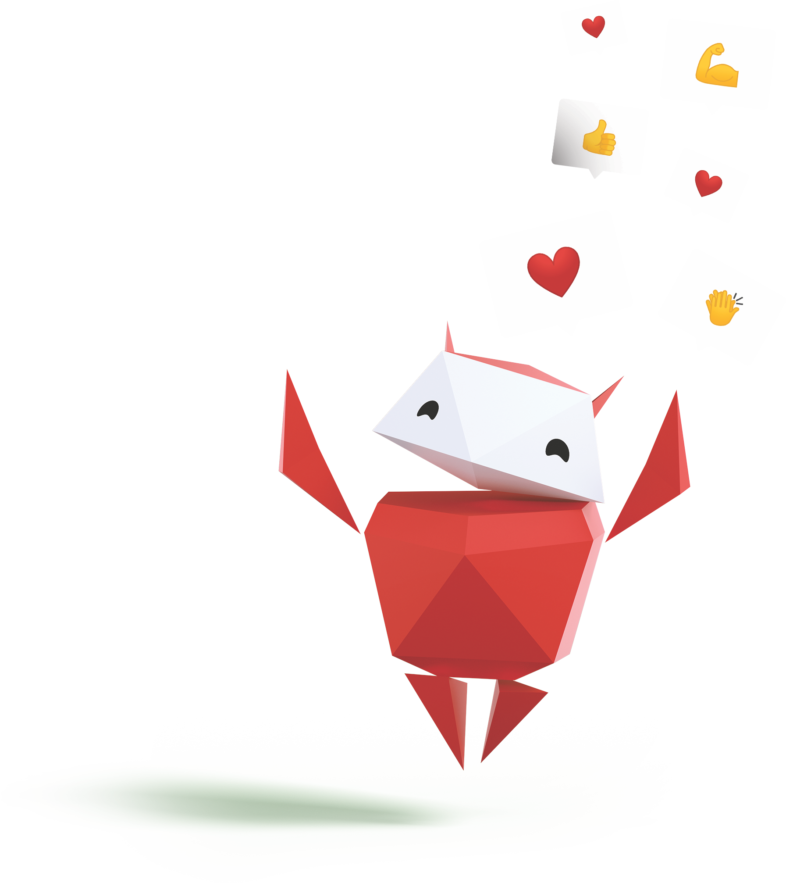
How can people be kind online?
What sort of things might they do?
Notes:
Baseline activity
Then say that you’re also going to be discussing being kind online. Ask: how can people be kind online? What sort of things might they do?

Slide 7
Strong passwords can keep you safe online
What makes a password strong?
A mix of uppercase and lowercase letters
Symbols and numbers
Long passwords
Notes:
Be Internet Sharp: Activity 2 - How to build a strong password (10 mins)
Explain to pupils that one of the ways that can help to ensure personal information is safe online is to use a ‘strong’ password. Ask them what they think is meant by a ‘strong’ password. (E.g. mix of upper and lowercase letters, symbols, numbers for letters, etc.)

Slide 8
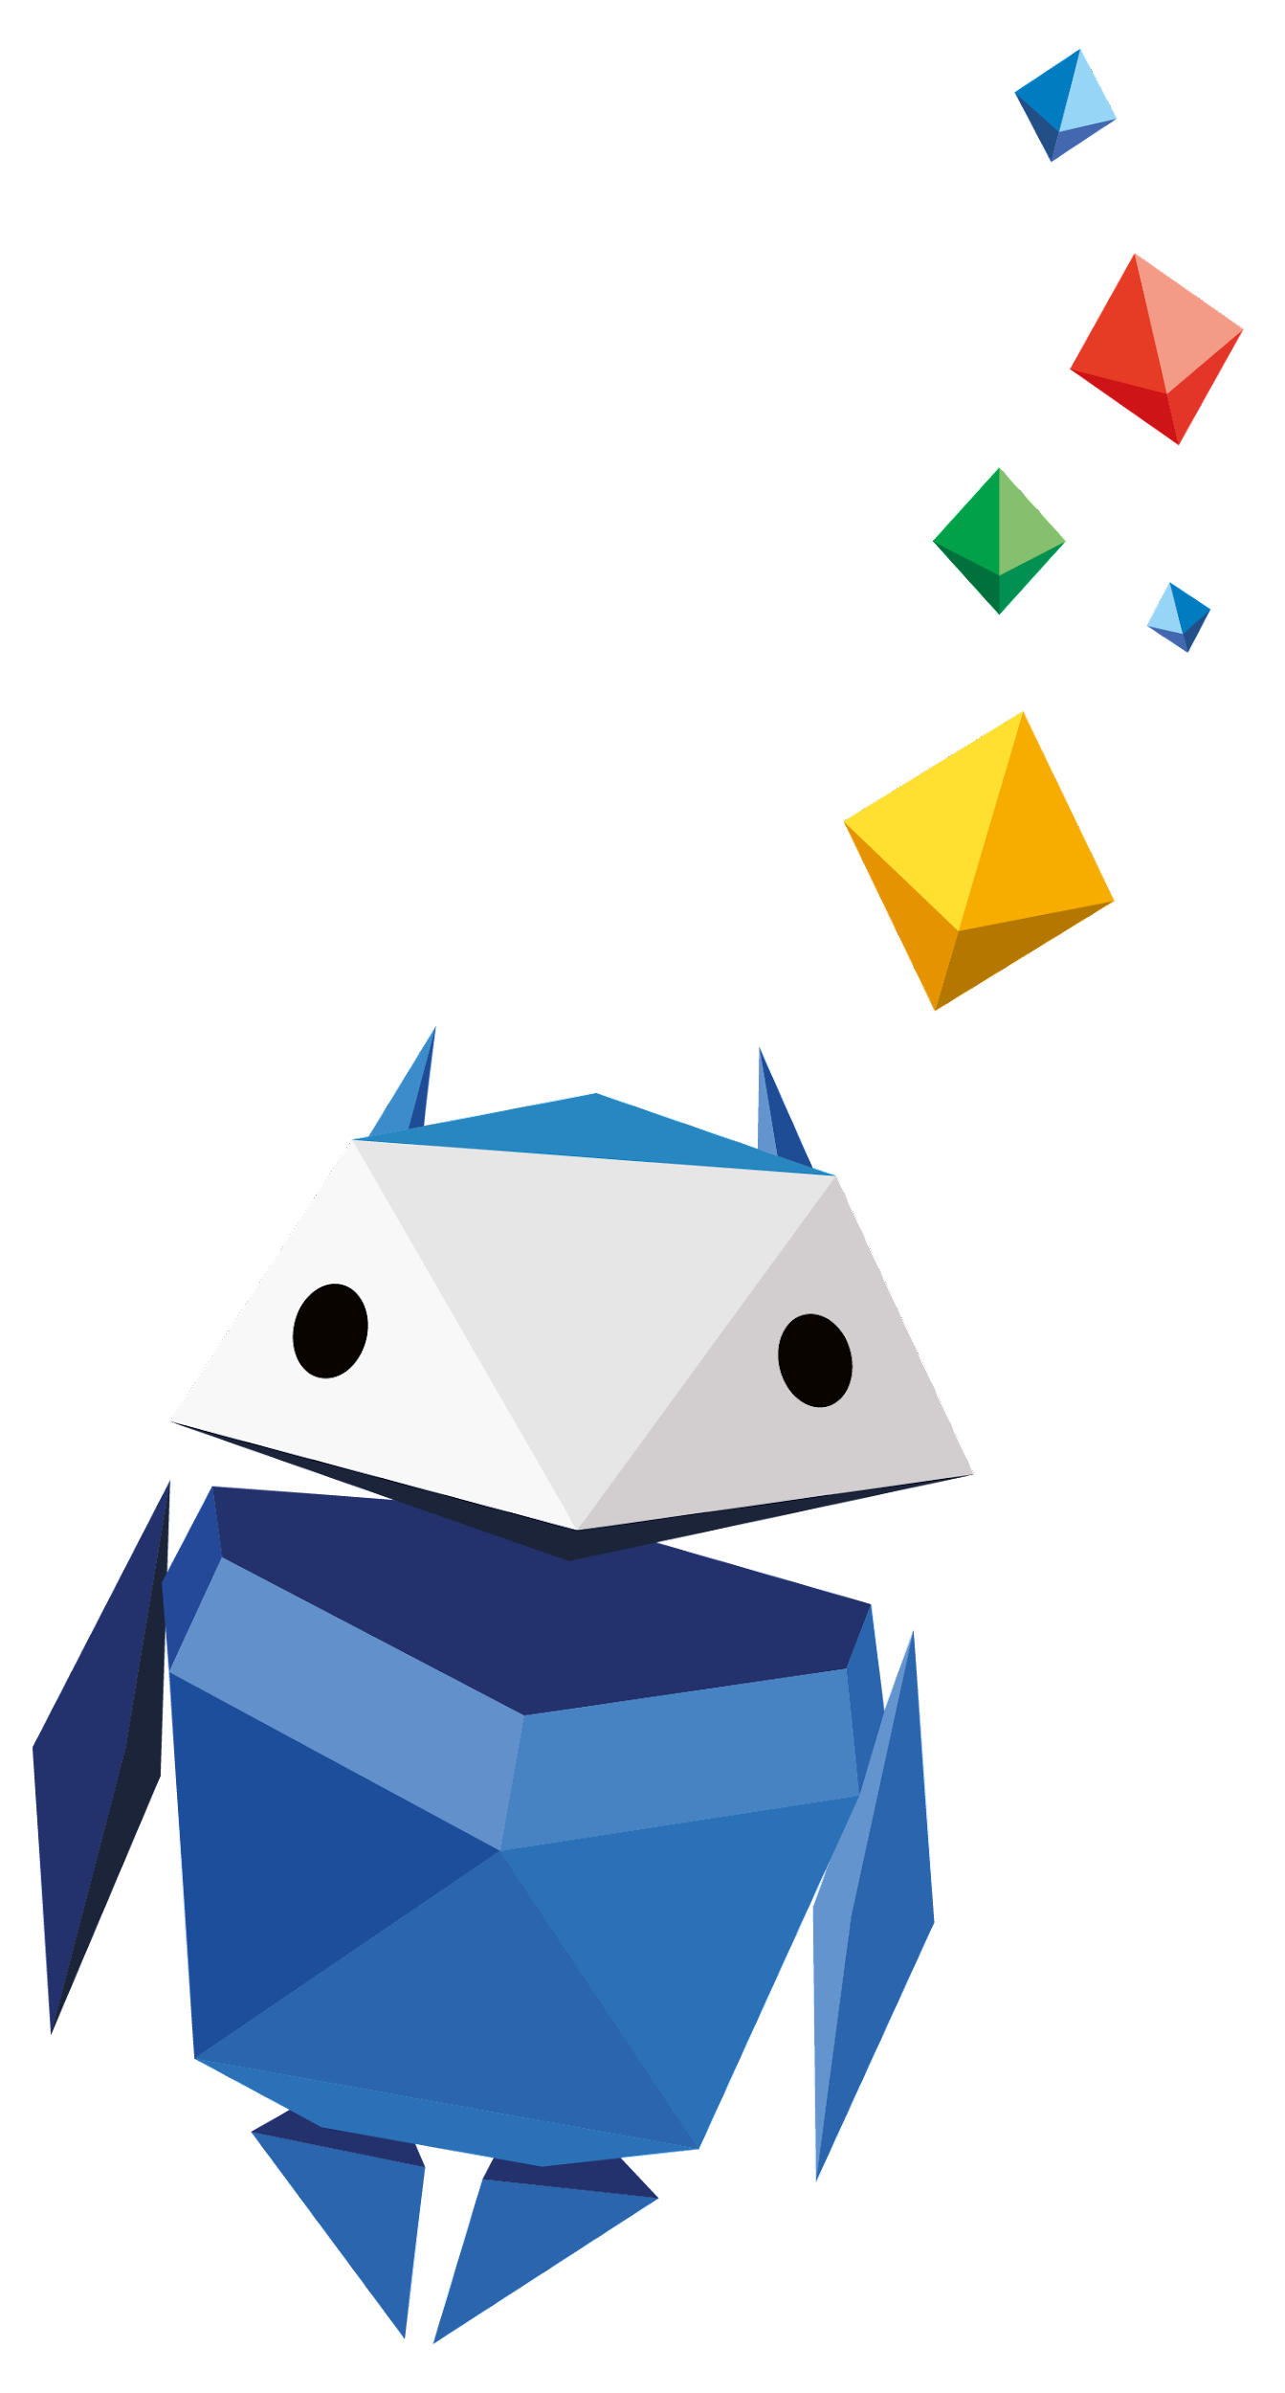
60-second challenge!
Create a strong password
Notes:
Be Internet Sharp: Activity 2 - How to build a strong password (10 mins)
Divide the class into teams of two pupils.
Each team has 60 seconds to come up with what they think is a ‘strong’ password. Ask two teams at a time to write their ‘strong’ passwords on the board.
Invite the class to vote on which passwords they think are ‘strong’. Pupils could also come up with examples of weak passwords and explain what makes them weak.
Support and Extension
Pupils needing support could be given some examples of weak passwords and asked how they could improve them. (E.g. ‘password’, ‘school’, ‘their name’). Pupils needing to be challenged could create a ‘Dos and Don’ts’ checklist on how to write a strong password and give clues to what a weak password would be.

Slide 9
Let’s talk!
Who came up with the strongest password?
Why was it the strongest?
Notes:
Be Internet Sharp: Activity 2 - How to build a strong password (10 mins)
Invite the class to vote on which passwords they think are ‘strong’. Pupils could also come up with examples of weak passwords and explain what makes them weak.
Pupils needing support could be given some examples of weak passwords and asked how they could improve them. (E.g. ‘password’, ‘school’, ‘their name’). Pupils needing to be challenged could create a ‘Dos and Don’ts’ checklist on how to write a strong password and give clues to what a weak password would be.

Slide 10
How can we change privacy settings?
Notes:
Be Internet Sharp: Activity 3 - Shh… Keep it to yourself (15 mins)
Choose a school device to demonstrate where pupils can locate privacy settings.
This can be undertaken on the teacher’s class computer and demonstrated via the class whiteboard, via pupils’ own school tablets or where laptops are located for lessons in computing.

Slide 11
What is two-step verification?
How do you turn on two-step verification?
Notes:
Be Internet Sharp: Activity 3 - Shh… Keep it to yourself (15 mins) Ask pupils if they have heard of the two-step verification process and explain how it works. (When you log into an account, it will be a two-step process, e.g. entering a password and another piece of memorable data about you.) Demonstrate going into My Account or Settings to explore privacy and security settings and show how privacy can be protected in this way.

Slide 12
Write down a catchy phrase…
To help you remember to change your privacy and turn on your two-step verification.
Notes:
Be Internet Sharp: Activity 3 - Shh… Keep it to yourself (15 mins) Ask pupils to compose a short slogan which helps them to remember the key advice.
Support and Extension Pupils needing support should be given a one-to-one explanation of the demonstration and could then create a ‘Shh.. Keep it to yourself!’ cartoon giving key advice, to reinforce their learning. This could be shared on the school website. Pupils needing to be challenged could create a ‘Shh... Keep it to yourself!’ rule to be shared in assembly. This could take the form of a mnemonic poem or rap.

Slide 13
1
Someone at your school has a bad haircut and isn’t happy with it.
Someone takes a photo and shares it online.
What can you do if you feel unsafe online?
Who can you tell or go to?
What might happen when you tell?
What might happen after that?
Notes:
Be Internet Kind: Activity 1 - Noticing feelings (10 mins)
This activity revisits the scenarios in Be Internet Sharp: Activity 4 - Keeping it private, this time focusing on help-seeking.
Give out the three scenarios/dilemmas from this activity to pupils to be discussed in their table groups.
Key questions to answer are:
• What can someone do if they feel unsafe online?
• Who can they tell or go to?
• What might happen when they tell?
• What might happen after that?
Support and Extension
Ask pupils who need support to discuss the scenarios with you, or another adult, focusing on what the person could do if they feel unsafe online and whom they tell in school and outside of school in each case. Ask those that need more challenge to design a ‘Who to go to’ flyer or poster for display in the classroom.
You could label the corner of each room teacher, parent, no-one, CEOP (the Child Exploitation and Online Protection command of the National Crime Agency). Read the scenario and ask pupils to move to the corner for the one they would tell and explain why they chose this option. Key point – you don’t tell ‘no-one’ if you see something upsetting!

Slide 14
2
Someone writes in their diary.
Another person copies what they wrote and posts it online.
What can you do if you feel unsafe online?
Who can you tell or go to?
What might happen when you tell?
What might happen after that?
Notes:
Be Internet Kind: Activity 1 - Noticing feelings (10 mins)
This activity revisits the scenarios in Be Internet Sharp: Activity 4 - Keeping it private, this time focusing on help-seeking.
Give out the three scenarios/dilemmas from this activity to pupils to be discussed in their table groups.
Key questions to answer are:
• What can someone do if they feel unsafe online?
• Who can they tell or go to?
• What might happen when they tell?
• What might happen after that?
Support and Extension
Ask pupils who need support to discuss the scenarios with you, or another adult, focusing on what the person could do if they feel unsafe online and whom they tell in school and outside of school in each case. Ask those that need more challenge to design a ‘Who to go to’ flyer or poster for display in the classroom.
You could label the corner of each room teacher, parent, no-one, CEOP (the Child Exploitation and Online Protection command of the National Crime Agency). Read the scenario and ask pupils to move to the corner for the one they would tell and explain why they chose this option. Key point – you don’t tell ‘no-one’ if you see something upsetting!

Slide 15
3
A group of friends are playing games together after school.
One of them posts the address and mobile number of the friend they are going to.
What can you do if you feel unsafe online?
Who can you tell or go to?
What might happen when you tell?
What might happen after that?
Notes:
Be Internet Kind: Activity 1 - Noticing feelings (10 mins)
This activity revisits the scenarios in Be Internet Sharp: Activity 4 - Keeping it private, this time focusing on help-seeking.
Give out the three scenarios/dilemmas from this activity to pupils to be discussed in their table groups.
Key questions to answer are: • What can someone do if they feel unsafe online?
• Who can they tell or go to?
• What might happen when they tell?
• What might happen after that?
Support and Extension
Ask pupils who need support to discuss the scenarios with you, or another adult, focusing on what the person could do if they feel unsafe online and whom they tell in school and outside of school in each case. Ask those that need more challenge to design a ‘Who to go to’ flyer or poster for display in the classroom.
You could label the corner of each room teacher, parent, no-one, CEOP (the Child Exploitation and Online Protection command of the National Crime Agency). Read the scenario and ask pupils to move to the corner for the one they would tell and explain why they chose this option. Key point – you don’t tell ‘no-one’ if you see something upsetting!

Slide 16
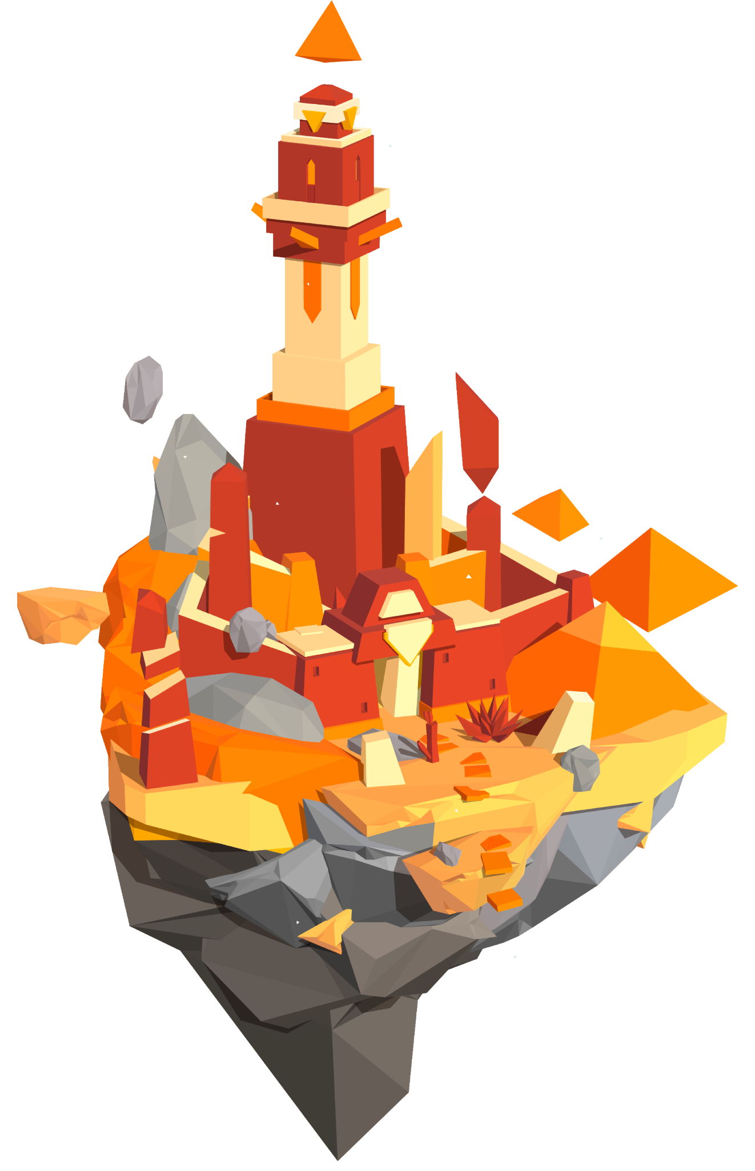
Time to visit…
Interland’s
Tower of Treasure
g.co/interland
Notes:
Be Internet Secure: Activity 5 - Interland: Tower of Treasure (20 mins)
An online game where pupils are asked to build an ‘untouchable’ password and secure made-up ‘private’ information on the game.
Pupils now have the chance to play Tower of Treasure in Interland, you can do this as a class or on separate devices.

Slide 17
Let’s talk!
When is it important to create strong passwords in real life? What tips have you learned on how to do so?
Whatʼs a Hacker? Describe this characterʼs behaviours and how they affect the game.
Did Tower of Treasure change the way you plan to protect your information in the future? How?
What are some examples of sensitive information that should be protected?
Notes:
Be Internet Secure: Activity 5 - Interland: Tower of Treasure (20 mins)
What are the elements of a super strong password?
When is it important to create strong passwords in real life? What tips have you learned on how to do so?
Whatʼs a Hacker? Describe this characterʼs behaviours and how they affect the game.
Did Tower of Treasure change the way you plan to protect your information in the future? How?
Name one thing youʼll do differently after learning these lessons and playing the game.
Craft three practice passwords that pass the ‘super strong’ test.
What are some examples of sensitive information that should be protected?

Slide 18
How would you find and ask for help if you felt unsafe online?
Reporting
Blocking
Speaking to a teacher, parent, friends, sibling, or another trusted adult
Something else?
Notes:
Be Internet Secure: Activity 5 - Interland: Tower of Treasure (20 mins)
Discuss with pupils: ‘How would you find and ask for help if you felt unsafe online?’ Possible answers:
• Reporting • Blocking • Speaking to a teacher, parent, friends, sibling or another trusted adult.

Slide 19
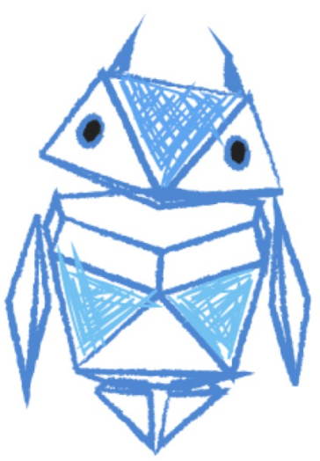
Draw someone who treats others kindly when they are online
Around the outside, draw or write the kind things that this person is thinking, saying, or doing
Notes:
Be a ‘Kindness Superhero’ (10 mins)
This is a standalone activity and does not require any additional resources.
Ask pupils to draw someone who treats others kindly when they are online.
Around the outside, ask pupils to draw or write what this person is thinking, saying and doing to demonstrate kindness online. Remind pupils about extending real life behaviour into online behaviour – e.g. don’t say things online that you wouldn’t say to someone face-to-face.

Slide 20
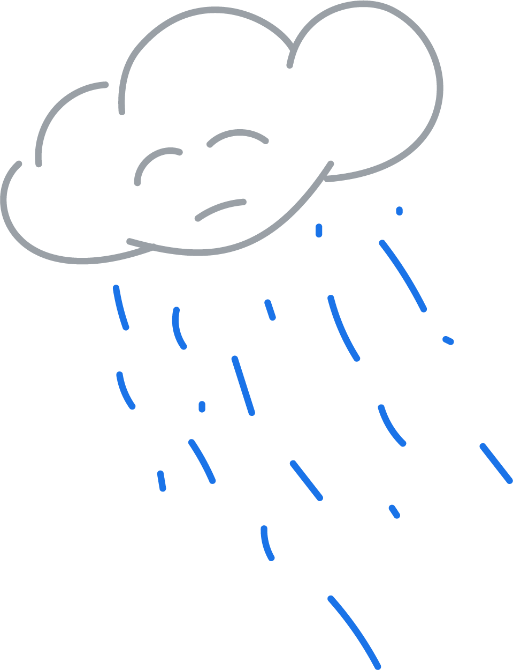
Imagine that you have seen or read some unkind behaviour online
Write or draw how that would make you feel.
Notes:
Be Internet Kind: Activity 2.1 - Your Kindness-gram (15 mins)
Ask pupils to write down words describing their feelings after they have witnessed or read unkind behaviour online.

Slide 21
What can you do to help?
Notes:
Be Internet Kind: Activity 2.1 - Your Kindness-gram (15 mins)
In groups, invite pupils to write down on a sticky note one practical suggestion for what the bystander could do to deal with the situation.
Make a class graffiti wall of the suggestions and read them out to the pupils. Which ones do they think would be particularly helpful.
Support and extension
Pupils needing to be challenged could create a rap/poem to share at a school assembly giving advice on how to combat unkind online behaviour. For pupils requiring support, ask them to use the graffiti wall suggestions to compose their own ‘Be cool when someone is cruel’ advice message or tweet.

Slide 22
Have you seen celebrities being unkind on social media?
Is this behaviour OK?
Notes:
Be Internet Kind: Activity 2.1 - Your Kindness-gram (15 mins)
Class discussion: Ask pupils to consider how some celebrities sometimes behave unkindly towards others when they are using social media. Remind them that this kind of behaviour does not present a good role model for others and only perpetuates that it is OK to be unkind online. As a class they now know how to be stand up for others and how to respond to unkind or unhealthy behaviour online.

Slide 23
Build a ‘Be cool when someone is cruel’ online advice checklist
Notes:
Be Internet Kind: Activity 2.1 - Your Kindness-gram (15 mins)
Ask pupils to devise their own ‘Be cool when someone is cruel’ online advice checklist for classroom display.

Slide 24
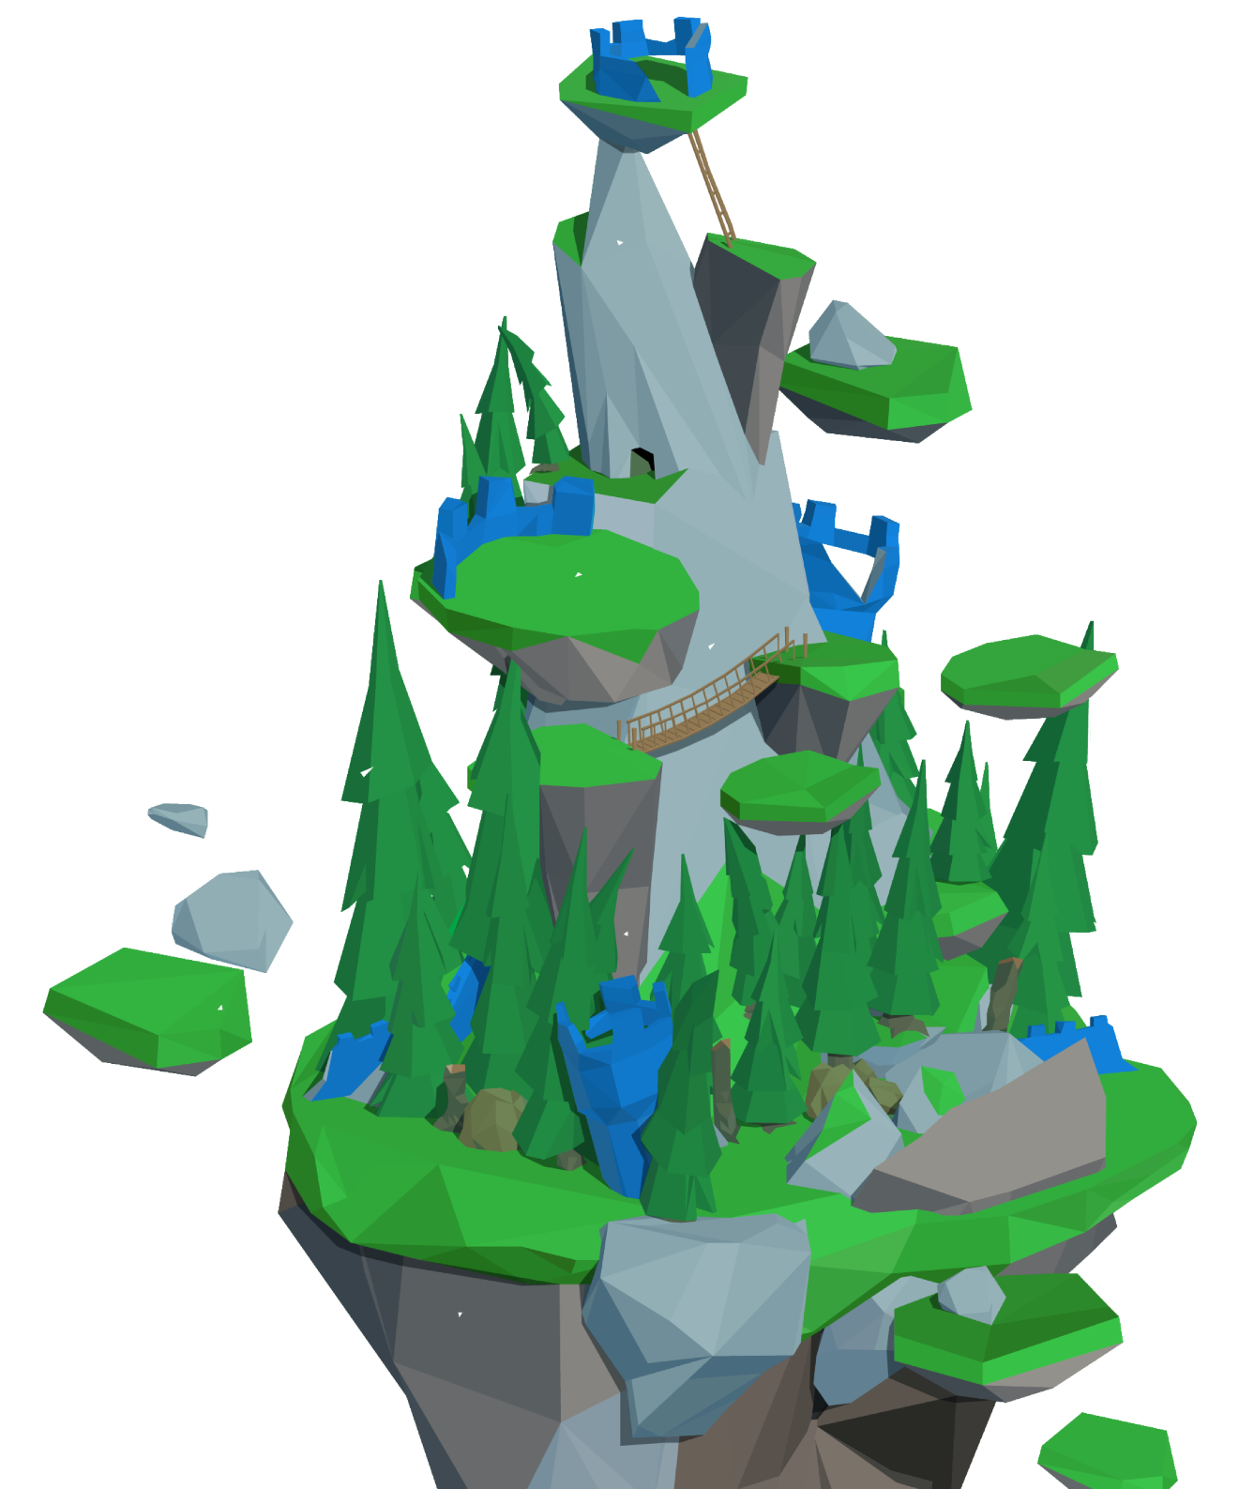
Time to visit…
Interland’s
Kind Kingdom
g.co/interland
Notes:
Be Internet Secure: Activity 6 - Interland: Kind Kingdom
Open a web browser on desktop or mobile device (i.e. tablet), visit g.co/interland and navigate to the land called Kind Kingdom. This is followed by the discussion questions in the activity section of the booklet.
Pupils now have the chance to play Kind Kingdom in Interland, you can do this as a class or on separate devices.

Slide 25
Let’s talk!
When would it be right to block someone online?
When would it be right to tell someone about someone else’s behaviour?
Why do you think the character in Kind Kingdom is called a Cyberbully?
What is the Cyberbully like? How does their behaviour affect the game?
Notes:
Be Internet Secure: Activity 6 - Interland: Kind Kingdom
Questions to ask after playing Kind Kingdom:
• When would it be right to block someone online? • When would it be right to tell someone about someone else’s behaviour? • Why do you think that the character in Kind Kingdom is called a Cyberbully? • What’s this character like? How does the Cyberbully’s behaviour affect the game?

Slide 26
Let’s talk!
What scenario in Kind Kingdom do you relate to most and why?
Describe a time when youʼve taken action to spread kindness to others online.
In what situation would it be appropriate to block someone online?
In what situation would it be appropriate to report someoneʼs behaviour?
Why do you think the character in Kind Kingdom is called a Cyberbully? Describe this characterʼs qualities and how their actions affect the game.
Does this game change the way you plan to behave towards others?
Notes:
Be Internet Secure: Activity 6 - Interland: Kind Kingdom
Questions to ask after playing Kind Kingdom:
• What scenario in Kind Kingdom do you relate to most and why? • Describe a time when youʼve taken action to spread kindness to others online. • In what situation would it be appropriate to block someone online? • In what situation would it be appropriate to report someoneʼs behaviour? • Why do you think the character in Kind Kingdom is called a Cyberbully? Describe this characterʼs qualities and how their actions affect the game. • Does this game change the way you plan to behave towards others?

Slide 27
Where do you rate your confidence now?
1 2 3 4 5 6 7 8 9 10
Not confident
Very confident
How have you learnt to be kind online?
Notes:
Plenary
(5 mins)
This refers back to the baseline activity on slide 2.
Invite pupils to revisit the scale they filled in at the beginning of the lesson. Where would they rate their confidence levels now?
Ask them to list two ways they can be kind online.

Slide 28
Design one of these postcards…
Be Internet Secure Top tips for staying secure online, like: strong passwords, privacy settings, & how to deal with strangers
Be Internet Kind How to stand up for others and what it means to be kind online
Notes:
Plenary
Ask pupils to begin creating a postcard that can be shared with their parents and siblings.
This can be finished at another point during the school day.
Give them a choice between the two pillars: Be Internet Secure and Be Internet Kind.
1. Postcard for Be Internet Secure
Top tips on how to stay secure online.
This may include tips on how to create a strong password, what to do if they receive messages from people they don’t know and how to manage their privacy settings on an app of their choosing.
These postcards could form part of a display in the classroom or elsewhere at school.
2. Postcard for Be Internet Kind
Top tips on how to stand up for others and what it means to be kind online.
These postcards could form part of a display in the classroom or elsewhere at school.

